Slide 1
Citation Styles!!!!!!
Work in MLA and APA
9-22-16

Slide 2
Plagiarism
The following is Clemson’s official statement on “Academic Integrity”: “As members of the Clemson University community, we have inherited Thomas Green Clemson’s vision of this institution as a 'high seminary of learning.’ Fundamental to this vision is a mutual commitment to truthfulness, honor, and responsibility, without which we cannot earn the trust and respect of others. Furthermore, we recognize that academic dishonesty detracts from the value of a Clemson degree. Therefore, we shall not tolerate lying, cheating, or stealing in any form.”
A simple definition of plagiarism—one that we will expand upon this semester—is when someone presents another person’s words, visuals, or ideas as his/her own. The instructor will deal with plagiarism on a case-by-case basis. The most serious offense within this category occurs when a student copies text from the Internet or from a collective file. This type of academic dishonesty is a serious offense that will result in a failing grade for the course as well as the filing of a formal report to the university.

Slide 3
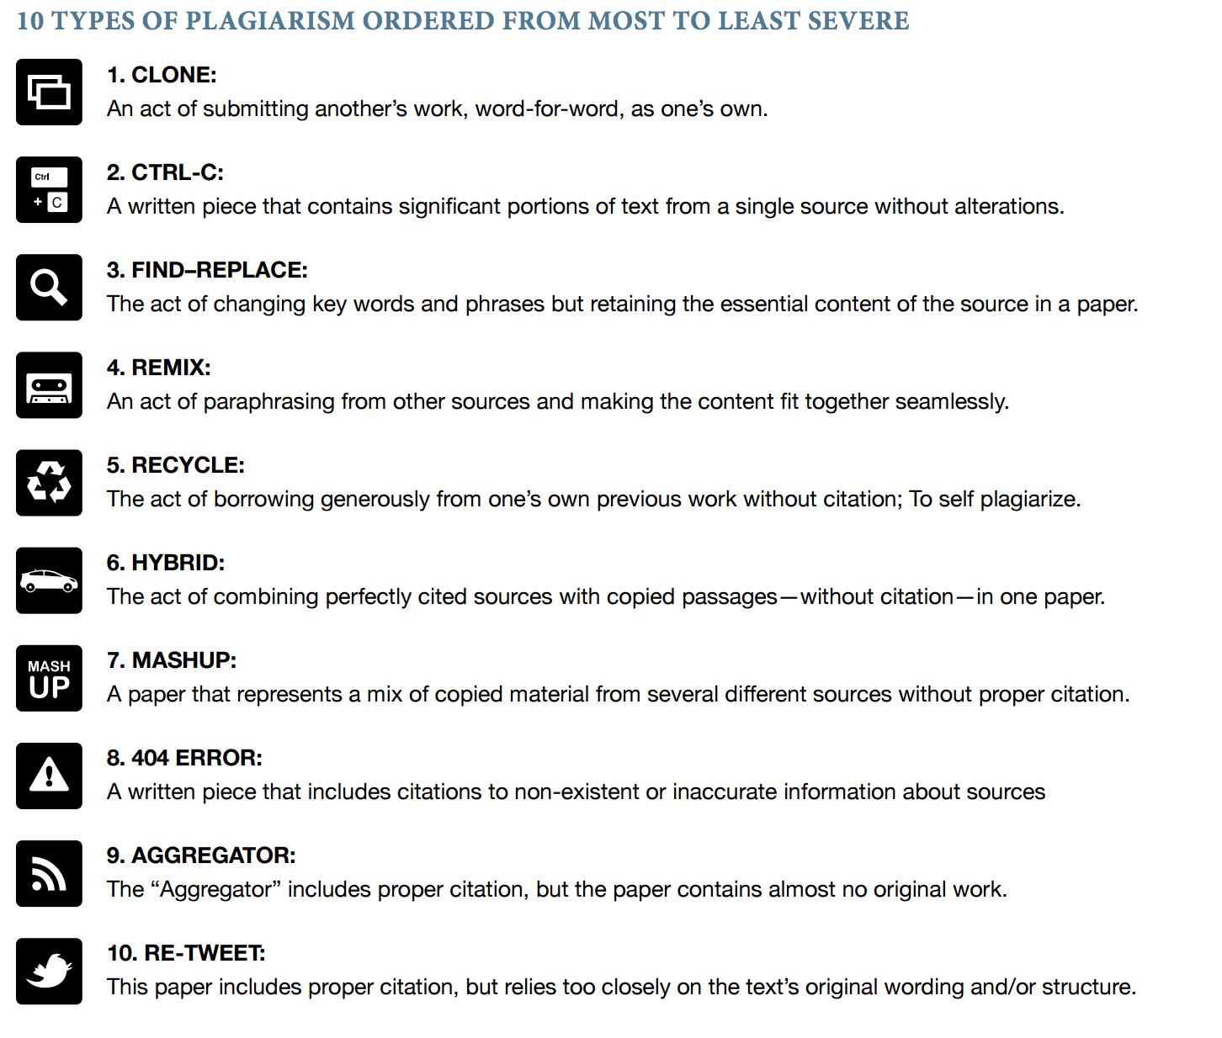

Slide 4
What is a “Citation Style”
It is a set of rules and conventions established by an organization or school (APA, MLA, Chicago, etc.) for formatting written work and documenting sources used in research.
“MLA” – Modern Language Association (Mostly used in humanities)
“APA” – American Psychological Association (Mostly used in science)
“Chicago” – Chicago or Turabian Style (Mostly in humanities publishing)

Slide 5
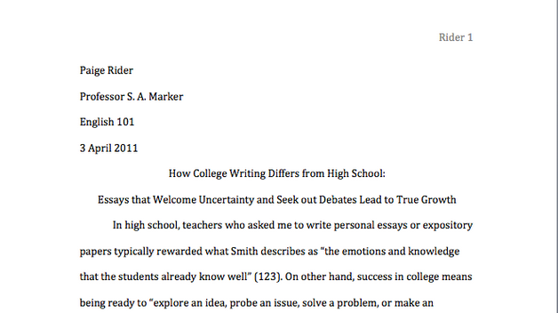
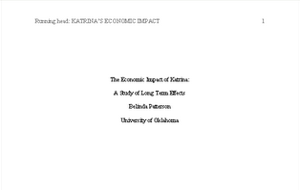
What style and why?
MLA is focused on the authors of the piece of writing and less with the date it was published.
APA is focused on the date of the document and when it was published more than who conducted the study.

Slide 6
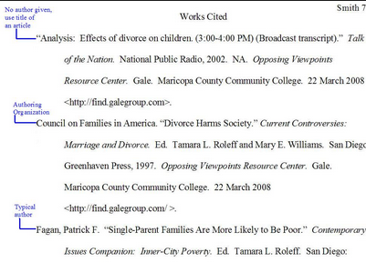
Modern Language Association (MLA)
MLA’s heading and general format is as follows:
-Typically 12pt Times New Roman font
-Heading is: Student, Professor, Class, Date (Sometimes assignment and word count) (Left Alignment)
-Title (Centered)
-Last Name and Page Number top right of page (Header)
“Works Cited”
-Alphabetical by Author/Organization/Title
-Author focus, then Title, then date
Writing in Action
Pg 400 starts general formatting
Pg 404 starts in-text citation
Pg 414 starts Works Cited

Slide 7
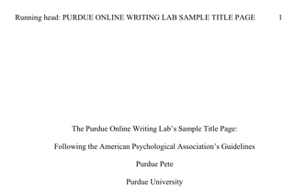
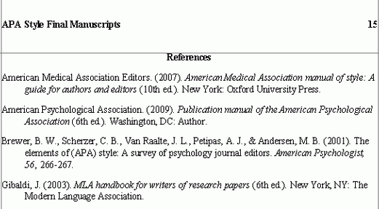
American Psychological Association (APA)
APA’s heading and general format is as follows:
-Typically 12pt Times New Roman font
-Title Page
-Running head: TITLE Page number on right
-Full Title, Name, Class/University, Professor, Date
(centered)
-Second Page always abstract (usually no more than 250
words)
“References”
-Alphabetical by Authors or Organization
-Author focus, date, publication
Writing in Action
Pg 455 starts general formatting
Pg 459 starts in-text citation
Pg 463 starts reference page

Slide 8
MLA In-Text Citations
How your information is introduced/used in the text will determine how your in-text citation is represented.
You always need to know who is the owner (author) of the information, as well as where you found the information.
There is a general appreciation for trees (Atwater).
Jacob Atwater said, in his book Finding Water, “we like trees” (23).
Humans generally say “we like trees” in parks (Atwater 23).

Slide 9
APA In-Text Citations
How your information is introduced/used in the text will determine how your in-text citation is represented.
Unlike MLA, APA doesn’t want you to direct quote, preferring paraphrase and summary. Remember to use past tense unless talking about results!
Atwater (2014) said we need to like trees.
Jacob Atwater (2014) said, in his book Finding Water, “we like trees” (p. 23).
Humans generally say “we like trees” in parks (Atwater, 2014, p. 23).

Slide 10
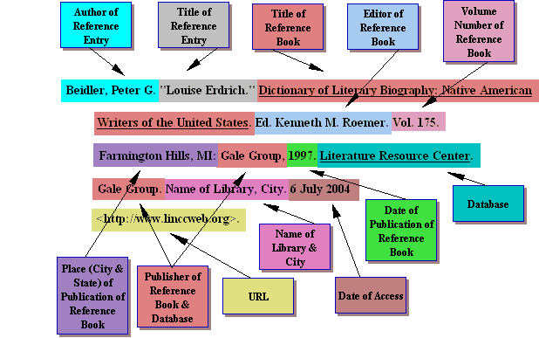
How to read a citation

